Slide 1
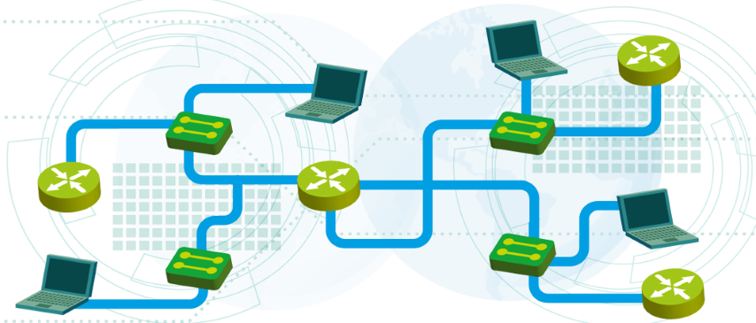

IP Addresses and Host-to-host Communication
Module 2
SoftUni Team
Technical Trainers
Software University
http://softuni.bg

Slide 2
Questions
sli.do #NetFund

Slide 3
Table of Contents
Binary, decimal and hexadecimal numbers
IPv4
Host-to-Host communication
Switch MAC Address table
Command line
Basic connectivity checks
Demo

Slide 4
Binary, decimal and hexadecimal numbers

Slide 5
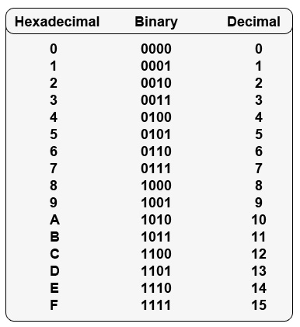
Different numeral systems
Common Numeral Systems in Computer Networking:
Decimal
Binary
Hexadecimal

Slide 6
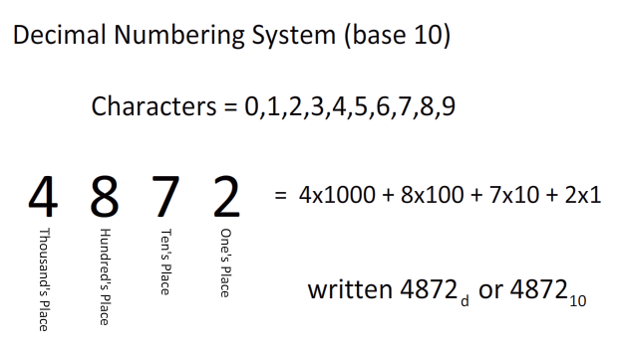
Decimal Numeral System
Base of 10
Called decimal or denary
A single digit can be: 0 1 2 3 4 5 6 7 8 9
In this example:
4x10³ + 8x10² + 7x10¹ + 2x10⁰ =
4000 + 800 + 70 + 2

Slide 7
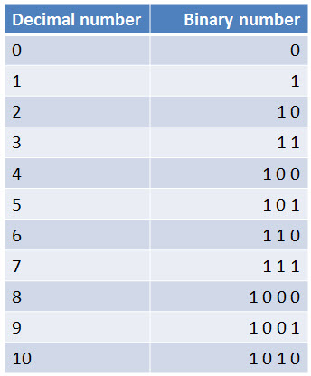
Binary Numeral System
Base of 2
Used in computers and all computer-based devices
Each digit is referred to as a bit
A single digit (bit) can be either 0 or 1

Slide 8
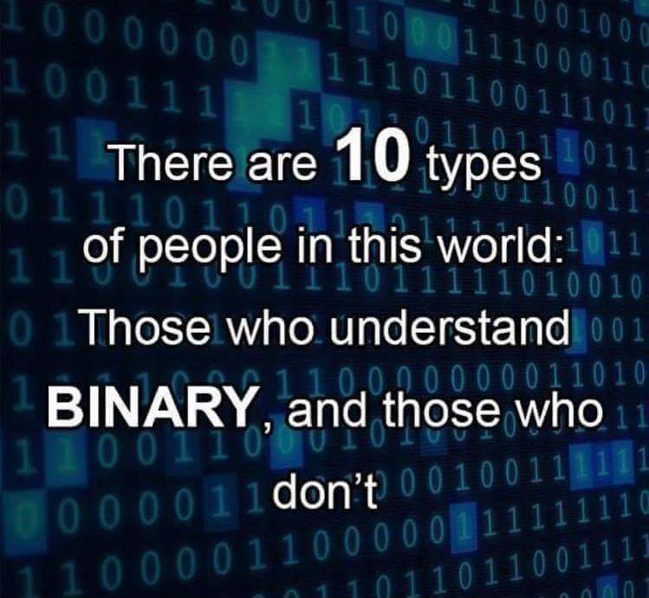
Binary joke

Slide 9
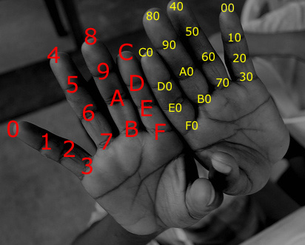
Hexadecimal Numeral System
Base of 16 (made of 16 symbols)
Widely used by programmers and computer designers
Used in MAC and IPv6 addresses
A single digit can be: 0 1 2 3 4 5 6 7 8 9 A B C D E F

Slide 10
Questions
sli.do #NetFund

Slide 11
IPv4

Slide 12
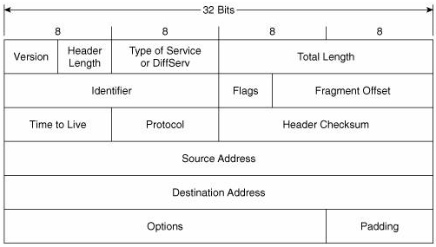
IPv4 Address
Plays important role for device connectivity
It is a 32-bit address
There are 4 294 967 296 IP addresses (2³²)

Slide 13
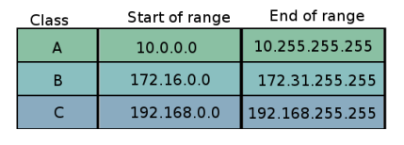
Private IP addresses
Used for addressing internal networks (offices, HQs etc.)
Not routable on the Internet
Can be reused in many networks
Range of private addresses for each class (classes are discussed later)

Slide 14
Public IP Addresses
Are not reserved for use in private networks
Globally routed between ISP routers
They are unique
Example: 87.20.114.156

Slide 15
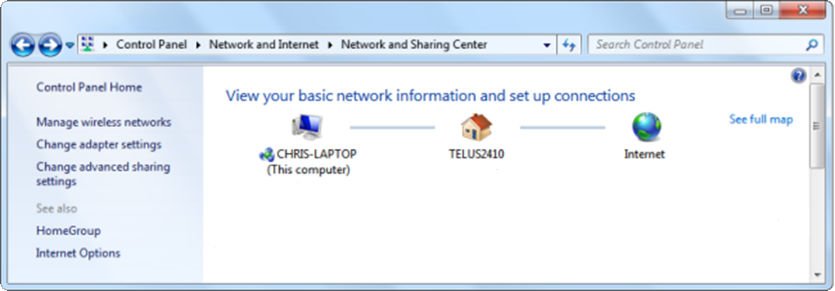
Public vs. private IP addresses
What are they?
When are they used?
Private Address
Public Address

Slide 16
NAT: Network Address Translation
It is a method of translating one IP address into another
Example : 192.168.17.45 ---> 227.206.89.76
Private
Public

Slide 17
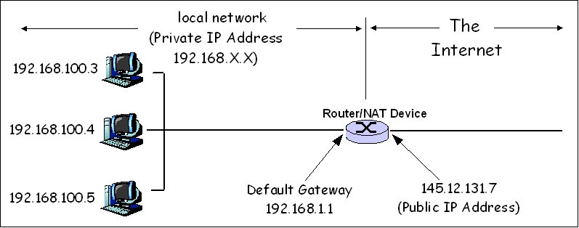
NAT (2)

Slide 18
Questions
sli.do #NetFund

Slide 19
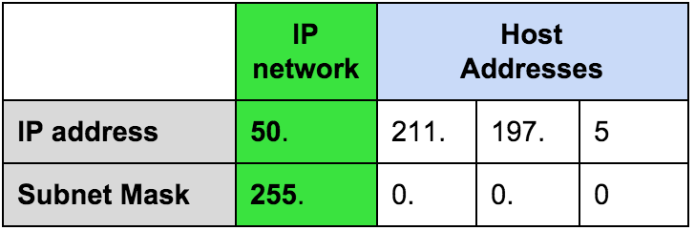
Network masks
Define the border between the network and the hosts part
Segment the network

Slide 20
Network masks – Example 1
Class A example:
In decimal: 255.0.0.0
Same mask written with prefix: /8
Same mask written in binary:
11111111.00000000.00000000.00000000
One byte full of 1’s. No address space
Three more bytes full of 0’s. This is 2²⁴ - 2 or 16 million computers

Slide 21
Network masks – Example 2
Class B example:
In decimal: 255.255.0.0
Same mask written with prefix: /16
Same mask written in binary:
11111111.11111111.00000000.00000000
Two bytes with 0’s. This is 2¹⁶ - 2 or 65534 computers

Slide 22
Network masks – Example 3
Class C example:
In decimal: 255.255.255.0
Same mask written with prefix: /24
Same mask written in binary:
11111111.11111111.11111111.00000000
One byte with 0’s. This is 2⁸ – 2 or 254 computers

Slide 23
Network masks – another example
Network part
Host part
Example:
Host IP address is: 192.168.1.8
Subnet mask is: 255.255.255.0

Slide 24
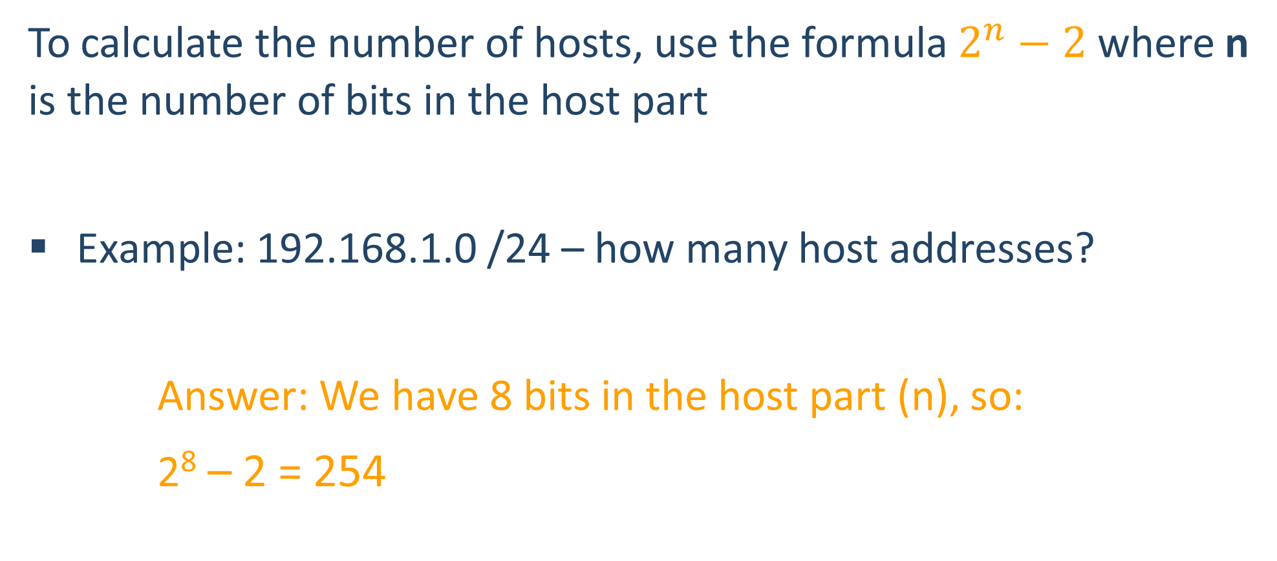
How many IP addresses for the hosts?
To calculate the number of hosts, use the formula $2^{n}−2$ where n is the number of bits in the host part
Example: 192.168.1.0 /24 – how many host addresses?
Answer: We have 8 bits in the host part (n), so:
2⁸ – 2 = 254

Slide 25
The Network and the Broadcast address
Two important and special addresses:
The network address – first possible address
The broadcast address – last possible address
These can NOT be assigned to hosts.

Slide 26
The Network and the Broadcast address (2)
Example:
192.168.1.5 /24
192.168.1.5
255.255.255.0
192.168.1.0 is the network address
192.168.1.255 is the broadcast address

Slide 27
A quick challenge
10.15.1.0
Is this a valid HOST IP Address?

Slide 28
A quick challenge (2)
Well…it depends!
Let’s see it with /23 mask. 10.15.1.0 /23 can be presented as:
10.15.00000001.00000000
255.255.11111110.00000000
First 23 bits
So, is it a valid host IP Address in this case?

Slide 29
A quick challenge (3)
In the example from the previous slide, which is the first and which is the last possible host address for the subnet to which this IP address belongs?
10.15.1.0 /23
10.15.0.0 is the network address
10.15.0.1 is the first host address
10.15.00000001.00000000
255.255.11111110.00000000
10.15.1.254 is the last host address
10.15.1.255 is the broadcast address

Slide 30
Questions
sli.do #NetFund

Slide 31
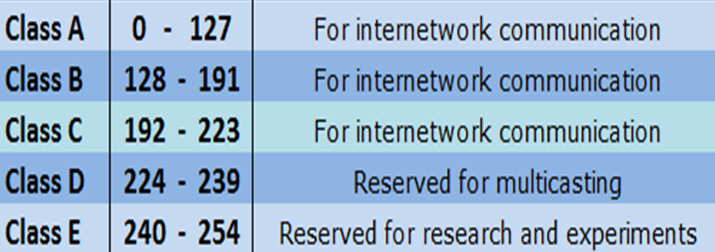
IP Address Classes
IP Address class is determined by the first octet (byte)
Three of them are used for addressing networks

Slide 32
IP Address Classes (2)
Examples of class A addresses
10.0.0.1
127.0.0.1
0.0.0.0
Examples of Class B addresses
172.16.67.8
169.254.x.x
Examples of Class C addresses
192.168.1.5
198.51.100.0

Slide 33
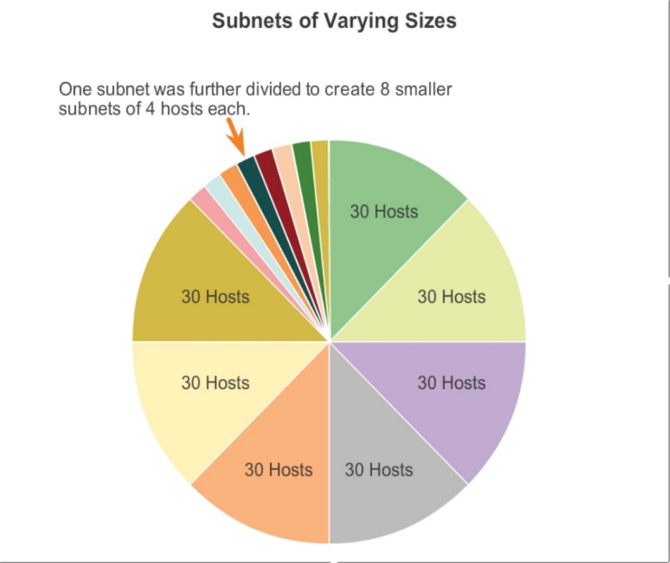
Introduction to VLSM
VLSM: Variable-Length Subnet Masking
Breaks the IP address classes idea
“Subnetting of subnets”

Slide 34
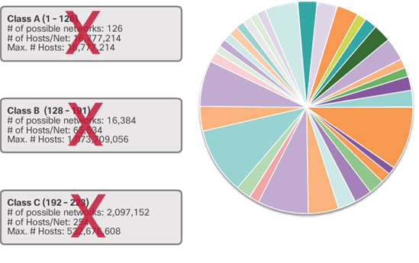
Introduction to CIDR
Ignores the concept Network Address Classes
Reduces the amount of route advertisements
Without VLSM and CIDR:
10.1.1.0 /24 will be “seen” as 10.0.0.0 /8
(because /8 is default for Class A)
With VLSM and CIDR:
10.1.1.0 /24 is “seen” as it is
(although the mask is NOT the default)

Slide 35
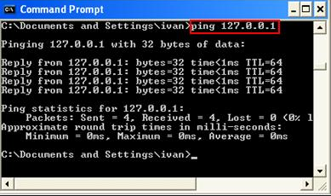
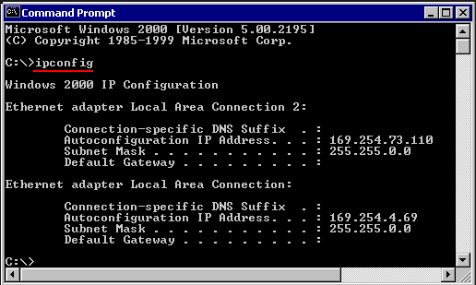
Reserved/Special IP Addresses
There are some special IP addresses. For example:
127.0.0.1 /8
Known as loopback address
On most computer systems, “localhost” resolves to the IP address 127.0.0.1
169.254.X.X /16
When DHCP is not reachable
Known as APIPA (Microsoft)

Slide 36
Questions
sli.do #NetFund

Slide 37
Host-to-host communication

Slide 38
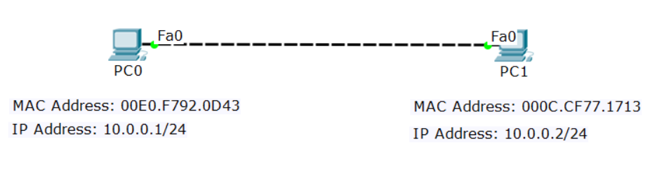
Four addresses required
There are 4 addresses needed for Ethernet communication:
Source IP | Destination IP
Source MAC | Destination MAC

Slide 39
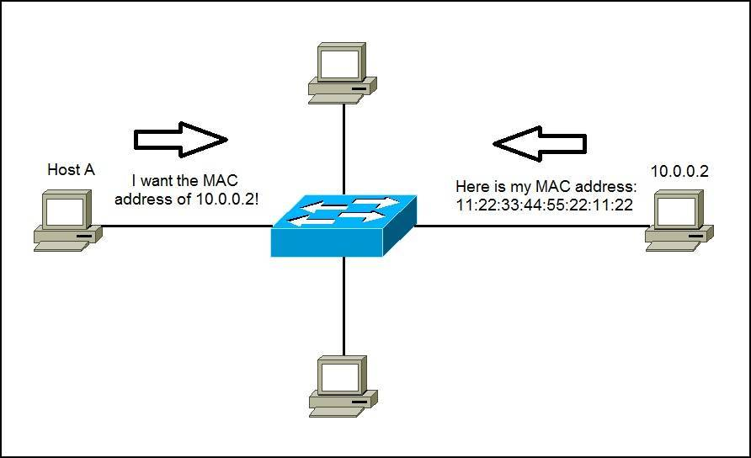
ARP: Address Resolution Protocol
Used to find the MAC address of the destination
Uses Broadcast

Slide 40
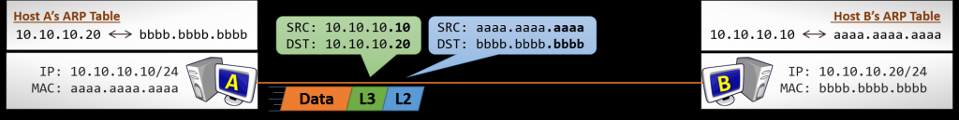
Direct communication (without router)
Source and destination MAC addresses are constant
Source and destination IP addresses are constant

Slide 41
Host-to-Host Communication With Routers
Source and destination MAC addresses are changed at every hop (router)
Source and destination IP addresses are constant (if we do not have NAT)

Slide 42
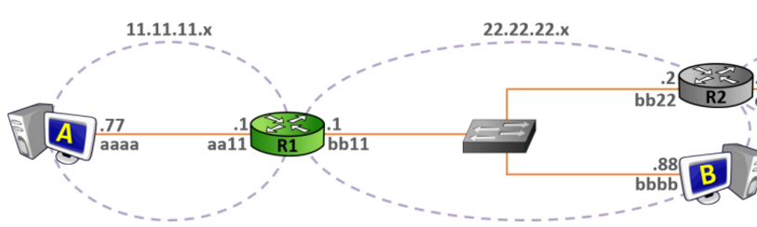
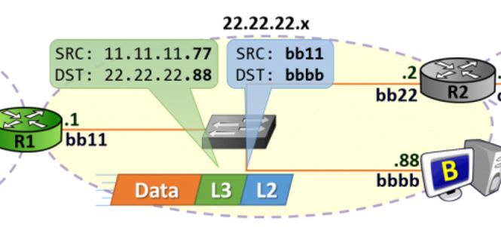
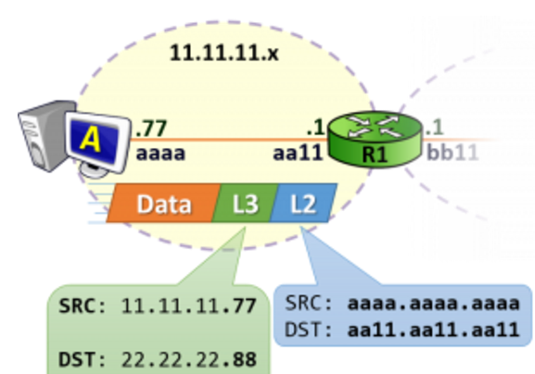
Host-to-Host Communication With Routers (2)

Slide 43
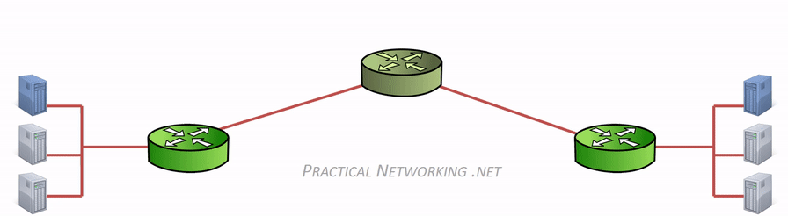
Host-to-Host Communication With Routers (3)
Source and destination MAC addresses are changed at every hop/router

Slide 44
Questions
sli.do #NetFund

Slide 45
Switch MAC Address table

Slide 46
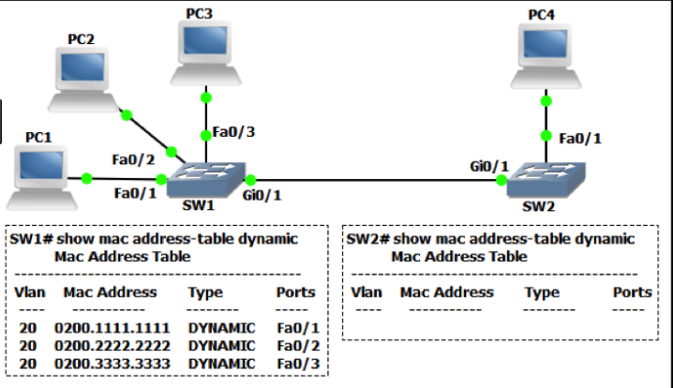
The MAC address table
It is a (dynamic) table that maps MAC addresses to ports
Used to find the proper interface when the switch forwards a packet

Slide 47
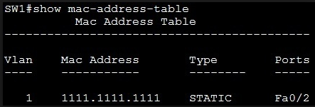
The MAC address table (2)
You can assign MAC Address statically as well
Pros : It is more secure
Cons: It is bit slower and harder for sysadmin to assign it manually

Slide 48
Questions
sli.do #NetFund

Slide 49
Command line

Slide 50
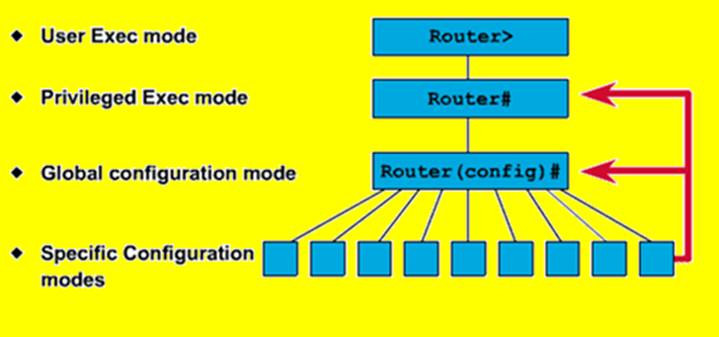
Command Line Introduction
Different vendors use different names but the logic is similar
Typical CLI modes:
Read-only (User)
Read-write (Privilege)
Configuration (Global config)
Sub-configuration

Slide 51
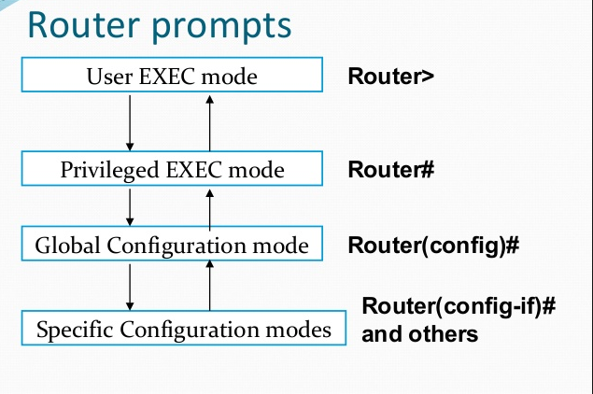
Command line
type “enable”
type “configure terminal”
Interface, VLAN, routing, etc.
to go back, type “exit”

Slide 52
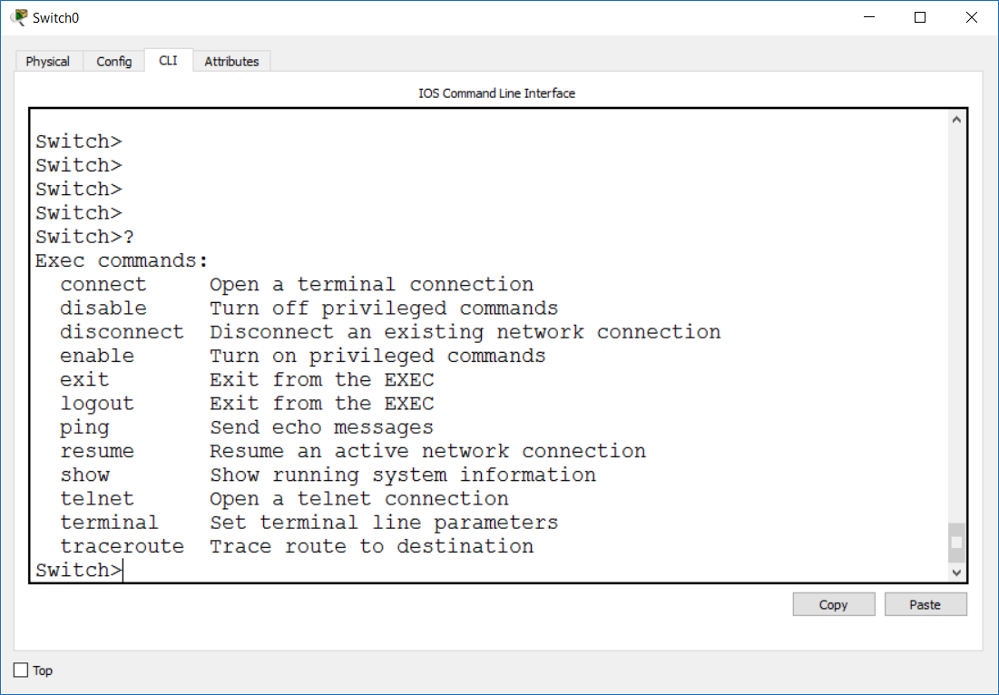
Using the Help – “?”
Use the “?” at each level to see the available commands

Slide 53
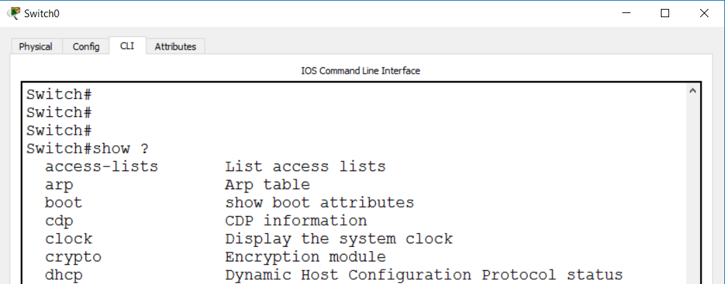
Using the Help – “?” (2)
Use the “?” as you type to see:
how to finish a command
what is/are the next word in the command

Slide 54
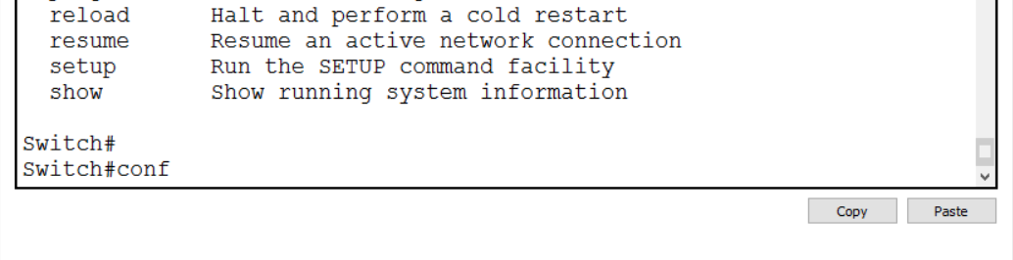
Using the Help – TAB
Hit the TAB key here to autocomplete “configure”

Slide 55
Questions
sli.do #NetFund

Slide 56
Basic connectivity checks

Slide 57
Basic Connectivity Checks
Ping (Layer 3)
Traceroute (Layer 3)
LLDP (Layer 2)
CDP (Layer 2)

Slide 58
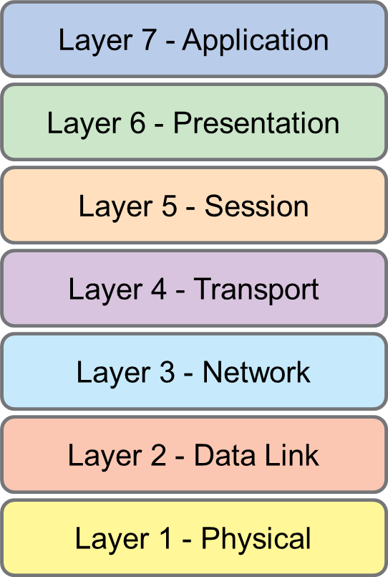
Ping
Important Layer 3 connectivity check
Must have IP addresses
ICMP echo request and ICMP echo reply
PING (and traceroute)

Slide 59
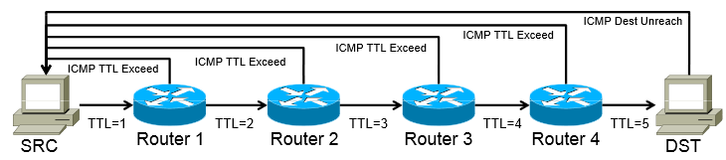
Traceroute
Another L3 connectivity check
Uses the TTL (Time to Live) value in the packet
Can determine the number of hops (routers) in the path

Slide 60
LLDP: Link Layer Discovery Protocol
Who is connected to me?
Works at Layer 2
Must be enabled on both sides
Vendor-neutral
LLDP (and CDP)

Slide 61
LLDP (2)
Gathered information with LLDP:
System name and description
Port name and description
VLAN name
IP management address
System capabilities (switching, routing, etc.)
MAC/PHY information
MDI power
Link aggregation

Slide 62
CDP: Cisco Discovery Protocol
Cisco proprietary
Gathers info about other Cisco (CDP) neighbor devices
Operates at L2
Turned on default by all Cisco switches and routers

Slide 63
Questions
sli.do #NetFund

Slide 64
Demonstration

Slide 65

Summary
Binary, decimal and hexadecimal numbers
IPv4
Host-to-Host communication
Switch MAC Address table
Command line
Basic connectivity checks
…
…
…

Slide 67



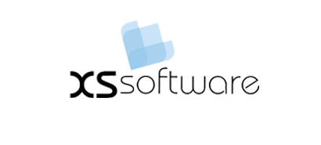


СофтУни диамантени партньори

Slide 68






СофтУни диамантени партньори

Slide 69





Trainings @ Software University (SoftUni)
Software University – High-Quality Education, Profession and Job for Software Developers
softuni.bg
Software University Foundation
http://softuni.foundation/
Software University @ Facebook
facebook.com/SoftwareUniversity
Software University Forums
forum.softuni.bg

